Slide 1
A PRACTICAL GUIDE TO MANAGING CONTINUING PROFESSIONAL DEVELOPMENT
Working and learning in the service

Slide 2
WHAT ARE THE PURPOSES OF CPD?

Slide 3
CONTINUING PROFESSIONAL DEVELOPMENT
For patient safety and ethics
For cost-effectiveness
For regulation of the profession
For improvement of the healthcare service
For personal and professional development and satisfaction
To meet international standards
All contribute to improvement of the service

Slide 4

HOW CAN WE MAKE CPD DELIVER THESE BENEFITS?
Collection of credits for activity is the most common system

Slide 5
WHAT ARE THE STRENGTHS AND WEAKNESSES OF A CREDIT-BASED SYSTEM?

Slide 6

IS COLLECTING CPD CREDITS EFFECTIVE?
No rationale for award of credit
No systemic relationship to need
No evidence of effect on practice
Doctors can participate just for ease or the meal…..
Not, not really
BUT…
Offers opportunities for CPD
Indicates that CPD is important
Good for the bureaucracy

Slide 7
THE CENTRAL PROBLEMS:
Collecting credits is an isolated process, not systematically linked with personal or service need
Credit recognition systems do not recognise actual effective ways of learning at senior level
Learning is a process, not an event
Credits can be offered for an effective learning process
HOW!?

Slide 8
WHAT QUALITIES DO YOU THINK THAT A SYSTEM OF CPD SHOULD HAVE?

Slide 9
HOW CAN CPD BE……
Transparent and accountable?
Regulated?
Relevant to improvement of the health care service?
Relevant to the interests of the individual clinician?
By using credits that recognise the process of learning rather than isolated events
Cost effective?
Based on effective learning methods?

Slide 10
A SIMPLE 4-STEP PROCESS
WHAT
will be learned?
HOW
will it be learned?
LEARN
USE
the learning and show effects

Slide 11
BUT FIRST………
How do senior doctors learn?
Research and experience tell us….

Slide 12
Foreword by
Dr Thomas Zilling,
European Association of Senior Hospital Physicians

Slide 13

SITUATED LEARNING
The process of professional education depends on immersion in practice
It is from immersion in practice that effective CPD arises
Depth of immersion increases with each successive stage of education and practice. At the level of CPD, it is total.

Slide 14
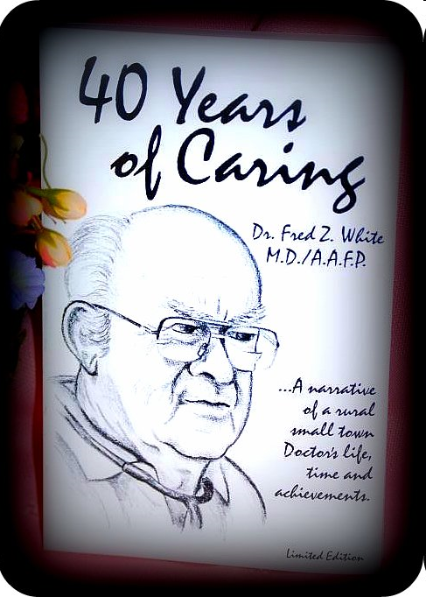
THIS DOCTOR LEARNS IN HIS OWN WAY……..
There is no best method of learning.
There is no widely shared preference.
How people like to learn depends on context, culture and purpose.
That is a challenge for credit-based systems that set different values on different ways of learning.

Slide 15

IS CPD AN ISOLATED EVENT?
CPD is an integral part of a doctor’s professional life – it is not a separate stream
THE CHALLENGE: To support doctors’ own ways of learning, not to force them into different ways just because they are measurable and observable

Slide 16

FACILITATING EFFECTIVE LEARNING
Doctors learn effectively in many ways already
There is no ‘best’ learning method: people vary
Effective learning can be:
  specifically needs related
  for the doctor’s general professional development
So there must be a large element of personal professional choice
Just linking CPD to known needs will not:
prepare for the future
promote development of the individual or the profession.
CPD cannot be used instrumentally.

Slide 17
SO WHAT WILL BE LEARNED IN THIS INDIVIDUAL WAY?
Although sometimes there will be a need to teach health care professionals about a developing condition e.g. HIV, ebola…………….
In general,……..

Slide 18

THERE IS NO CPD CURRICULUM
And there should not be one that is pre-specified
It must arise from the practice and judgement of doctors and from emerging health service needs.

Slide 19
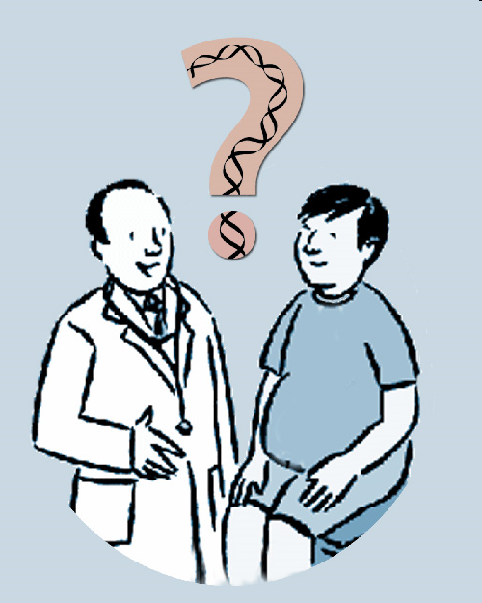
ENSURE THAT LEARNING IS RELATED TO PRACTICE
Doctors are unlikely to
share many common
learning needs: CPD
needs arise from
practice and judgment
THE CHALLENGE:
To find ways of supporting individual doctors to identify learning needs arising from practice and feed that back into their practice

Slide 20
DO WE NEED TO TEACH DOCTORS THE SKILLS OF EFFECTIVE LEARNING?
The Good CPD Guide
Can they identify their learning needs?
48 methods of learning needs assessment
Do they meet the needs of the health care service?
Planning CPD in relation to the development of the service
Do they continue to learn?
40 methods of learning
Do they show effectiveness & reinforce learning in practice?
41 ways of showing effectiveness and reinforcing learning

Slide 21
ALL WE NEED TO DO IS……
Build all this into a managed system for CPD

Slide 22
A SIMPLE 4-STEP PROCESS
WHAT
will be learned?
HOW
will it be learned?
LEARN
USE
the learning and show effects

Slide 23
STEP | METHOD | EFFECT
1. IDENTIFY WHAT TO LEARN
Context factors [service needs]
Peer appraisal
personal need,
professional developments,
needs of the health service
Ensures that intended learning derives from:
Reflection
QA processes

Slide 24
HOW CAN DOCTORS IDENTIFY THEIR LEARNING NEEDS?
Reflect on your own experience.
When did you last learn something new in your specialty?
Why did you learn that?

Slide 25
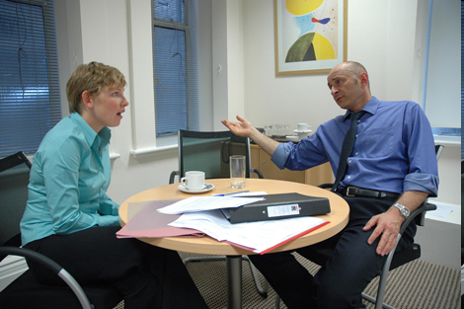
THE UK APPRAISAL PROCESS
Peer review of doctor’s performance
Personal reflection
Consider doctor in the local healthcare service
Set out development needs
Agree learning plan
Seek support for the learning
Part of revalidation / relicensure

Slide 26
STEP | METHOD | EFFECT
2. PLAN HOW TO LEARN
Personal development plan, or other record
A rational and transparent record is created

Slide 27
PERSONAL DEVELOPMENT PLAN
An action plan,
based on awareness, reflection, goal-setting and planning learning
for personal development in the context of a career, the job, education, or self-improvement
So you have a record for accountability and bureaucracy

Slide 28
STEP | METHOD | EFFECT
3. LEARN
In any way that is appropriate to the need, the person, and the context
Learning is personally effective

Slide 29
HOW DO YOU KEEP UP TO DATE?
Methods of professional learning

Slide 30
EFFECTIVE PROFESSIONAL LEARNING METHODS
Academic activities
Meetings
Learning from colleagues
Learning from practice
Technology-based learning and media
Management and quality processes
Specially arranged educational events
No rational reason for assigning a credit value to any of these – all are valid

Slide 31
STEP | METHOD | EFFECT
4. USE THE LEARNING AND SHOW EFFECTS
Learning is carried back to the workplace and service
Incorporation into practice
Further learning
Dissemination to others

Slide 32
HOW CAN YOU TAKE YOUR LEARNING BACK TO THE WORKPLACE?

Slide 33
TAKING LEARNING BACK TO THE WORKPLACE
Reviewing practice
Teaching others
Changing practice
Confirming current practice
This will improve the healthcare service!

Slide 34
CAN THE QUALITY OF CPD BE MEASURED BY OUTCOMES?
NO because
Too many intervening and uncontrollable variables between learning and patient outcomes
The conditions of practice sometimes stop new learning being used
Doctors must acquire new knowledge that may not be predictably used e.g. If patients do not require it
Not all CPD should be instrumental. Some must be for general professional updating.

Slide 35



WHAT?
HOW ?
LEARN
USE
The key to effective CPD is in how the process is managed:

Slide 36
HOW CAN MANAGED CPD IMPROVE THE HEALTHCARE SERVICE?

Slide 37
MANAGED CPD CAN IMPROVE THE HEALTHCARE SERVICE BY:
Deriving from health service needs
Being tailored to the individual doctor's needs and practice
Assuring return to practice
Allowing a personal learning plan that suits the individual
Transparent and monitorable
Allowing targeted CPD when healthcare service development requires that

Slide 38
FORMAL RECOGNITION OF THIS PROCESS IS REQUIRED
For credits or certification

Slide 39
Process
Documentation
Credits
For the profession
For the doctor
For the service
For regulation
For transparency and accountability

Slide 40
WHAT
will be learned?
HOW
will it be learned?
LEARN
USE
the learning and show effects
To help the profession and the service to do better what it does well already.

